Slide 1


Design & Develop Front End Community Portal
Module Project
Module: NICF-UI Frameworks
Course: NICF-Advanced Certificate in Web Development
Start Date : 21 June 2022
End Date : Submission Date :
Learner Name Enrollment ID
: Ida Bagus Ketut Yoghantara
: BDSE04-0322
19 July 2022
14 July 2022
Presentation Date :

Slide 2
Document History
Version Number | Effective Date of release | Summary of Included Changes | Author
1 | 4th March 2016 | First Edition | Satya CVS
2 | 7th April 2017 | Changed for Module 2 | Shrinivas K R
3 | 14th May 2017 | Changed for Module 3 | Shrinivas K R
4 | 03rd May 2018 | Changed for RQF | Shrinivas K R
5 | 16th Sep 2018 | Change for Java Track | Shrinivas K R

Slide 3
Contents
S. No. | Description
01 | Development Tools
02 | Feedback Techniques
03 | Pages Inventory
04 | Forms & Pages Design
05 | Forms & Pages Feedback
06 | HTML Pages
07 | Usability Metrics
08 | User Interaction Steps
09 | User Interaction Flowchart
10 | Current & Desired Usability
11 | Prototype Screen
12 | Prototype Feedback
13 | Usability Test
14 | Project Milestones & Tasks
15 | Milestone Feedback & Action taken
16 | Project Results
17 | Proposed Improvements

Slide 4


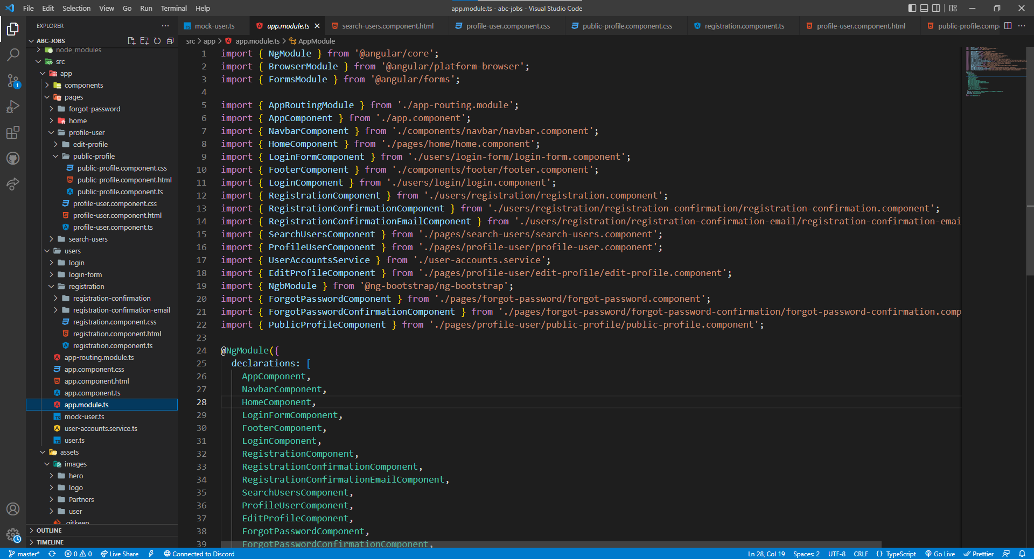
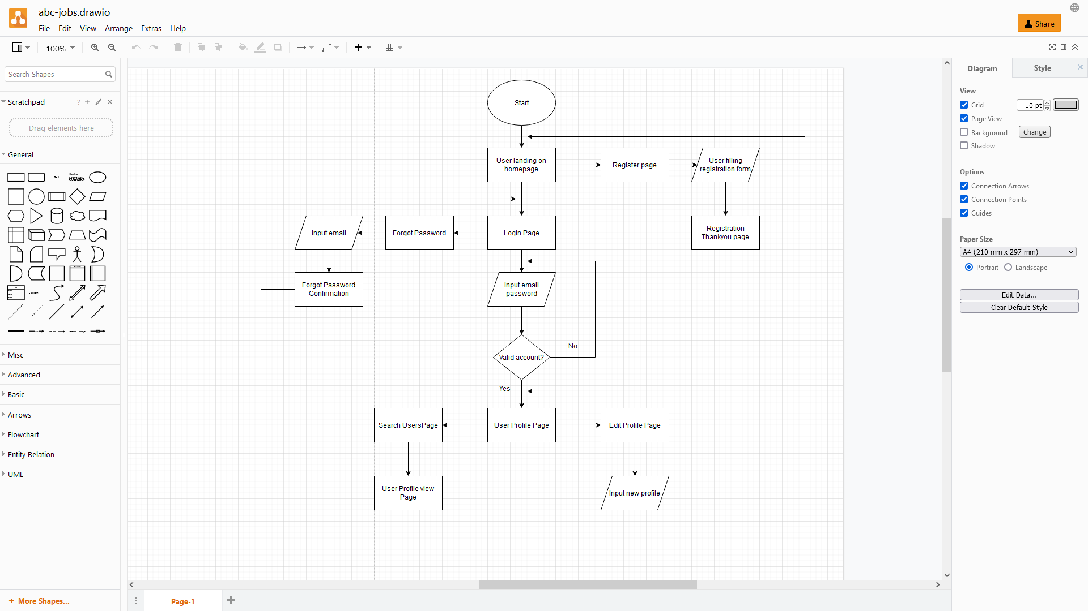
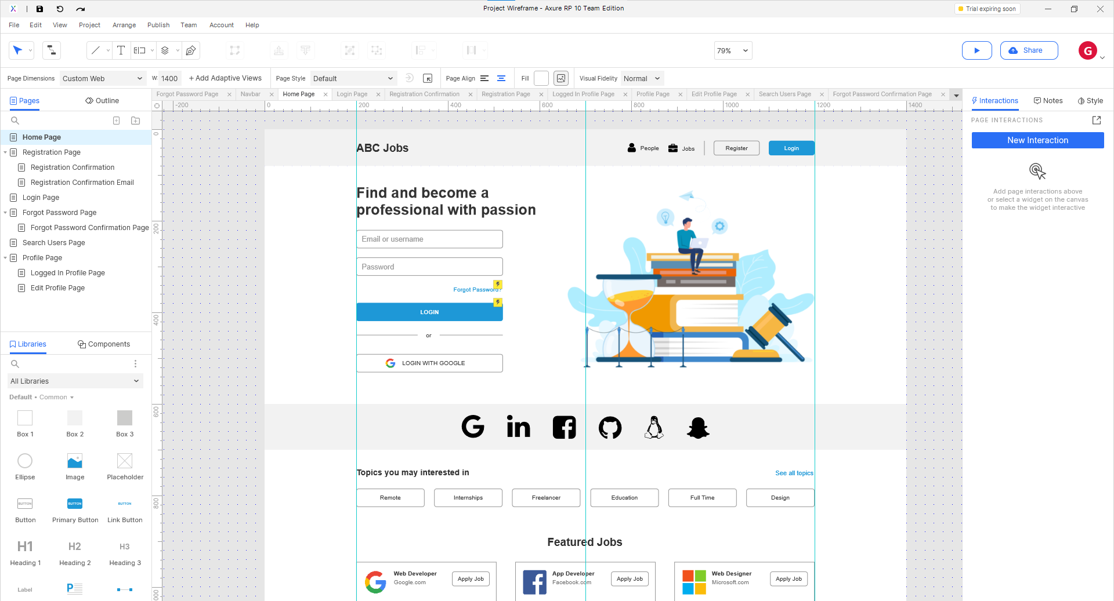
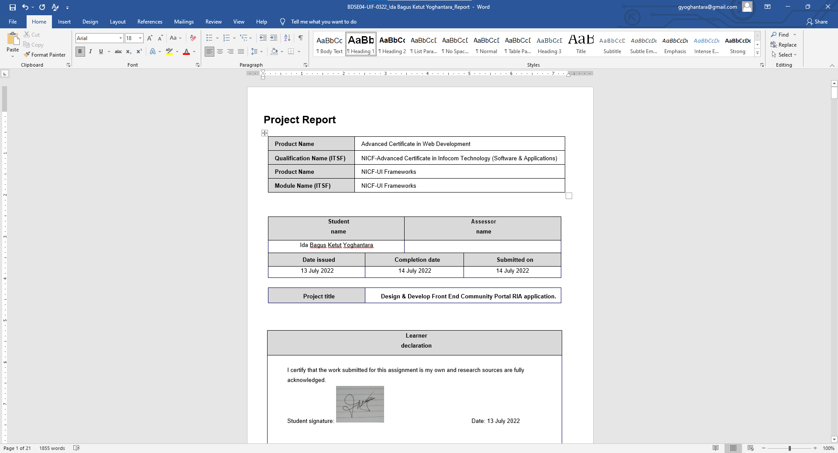
1. Development Tools
Development Tools Screen captures

Slide 5

2. Feedback Techniques
Feedback gathering techniques
There are two ways to collecting the feedback data, quantitative and qualitative .
Quantitative feedback is collecting the data base on the similarity. Quantitative feedback focuses on getting as many answers as possible. Then, conclusions are drawn based on statistics. This type of feedback relies heavily on quick, multiple choice questions, which are easy to fill in and don’t cause a high dropout rate. Those questions give a choice between a selection of answers your team considered to be the most likely.
Qualitative feedback is collecting and analyze the data. Qualitative feedback focuses on getting detailed answers, in order to gain a deeper understanding. This is where open-ended questions come handy and are often used by marketers to gain insights into the opinions and behavior of their customers. Such types of questions can give you a wide range of different responses, some you might not have expected. Thus, you can improve your company in ways you didn’t think were possible.

Slide 6
3. Pages Inventory
List of Pages for which UI need to be developed
S. No. | Page Name
1 | Community Portal Home Page
2 | Registration Page
3 | Registration Confirmation Page
4 | Update Profile Page
5 | Search Users Page
6 | List Search Results
7 | Public Profile Page
8 | Registration Confirmation Email
9 | Login Page
10 | Forget Password Page
11 | Design the Forget Password Confirmation Page

Slide 7
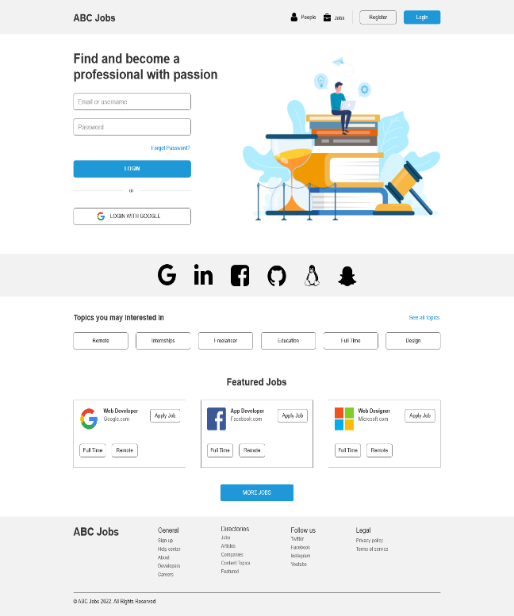
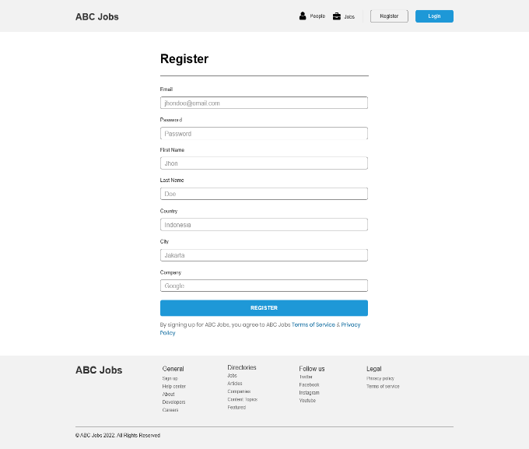
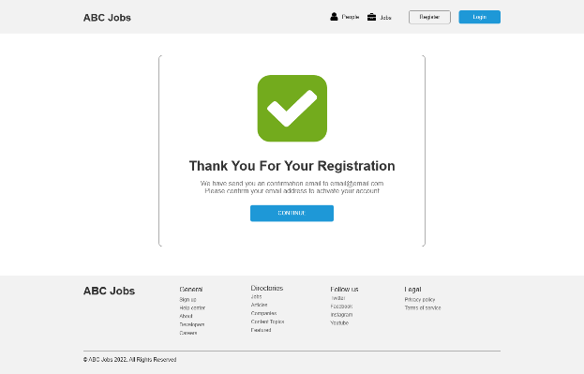
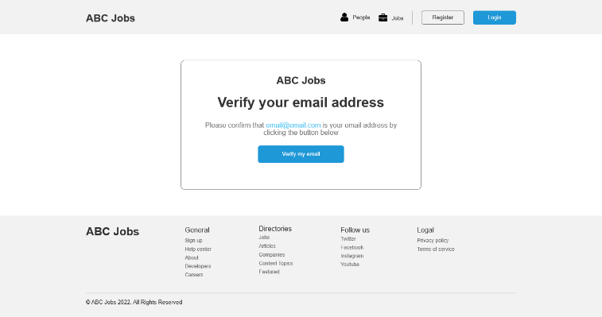
4. Forms & Pages Design
Homepage
Registration Page
Registration Confirmation Page
Registration Confirmation Email Page

Slide 8
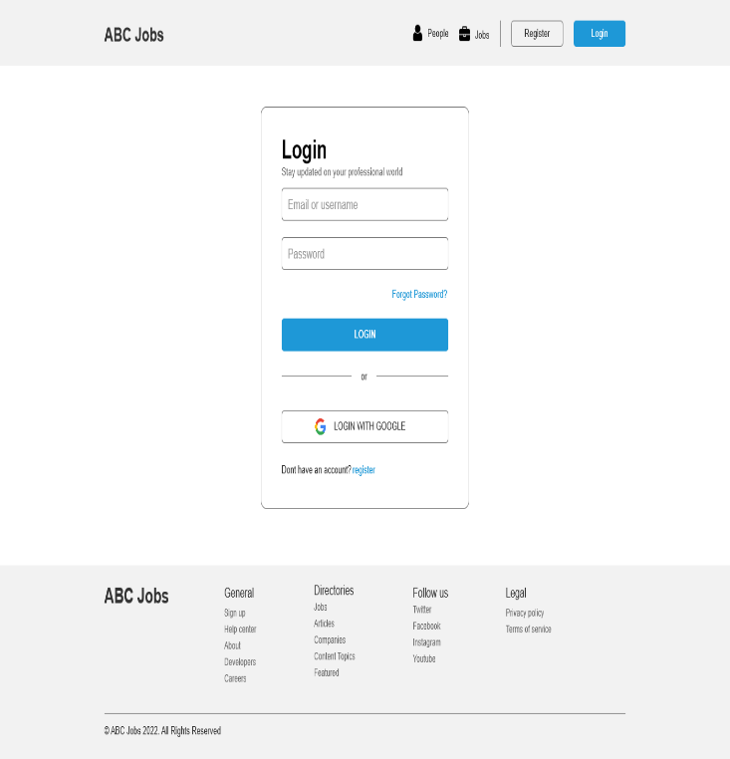
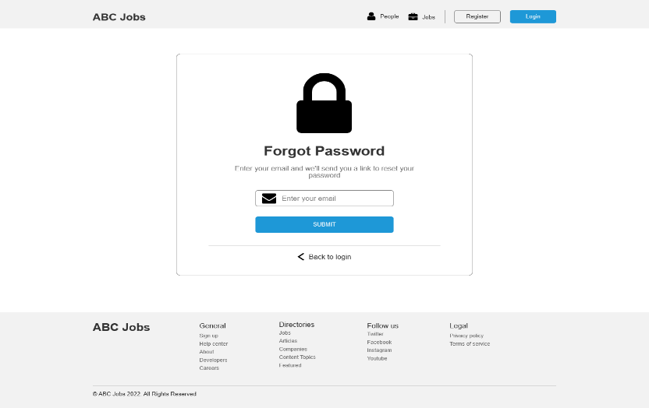
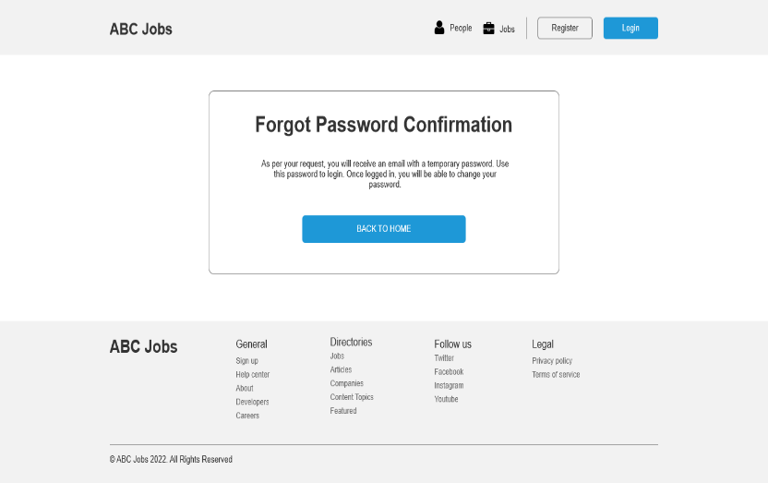
4. Forms & Pages Design
Login Page
Forgot Password Page
Forgot Password Confirmation Page

Slide 9
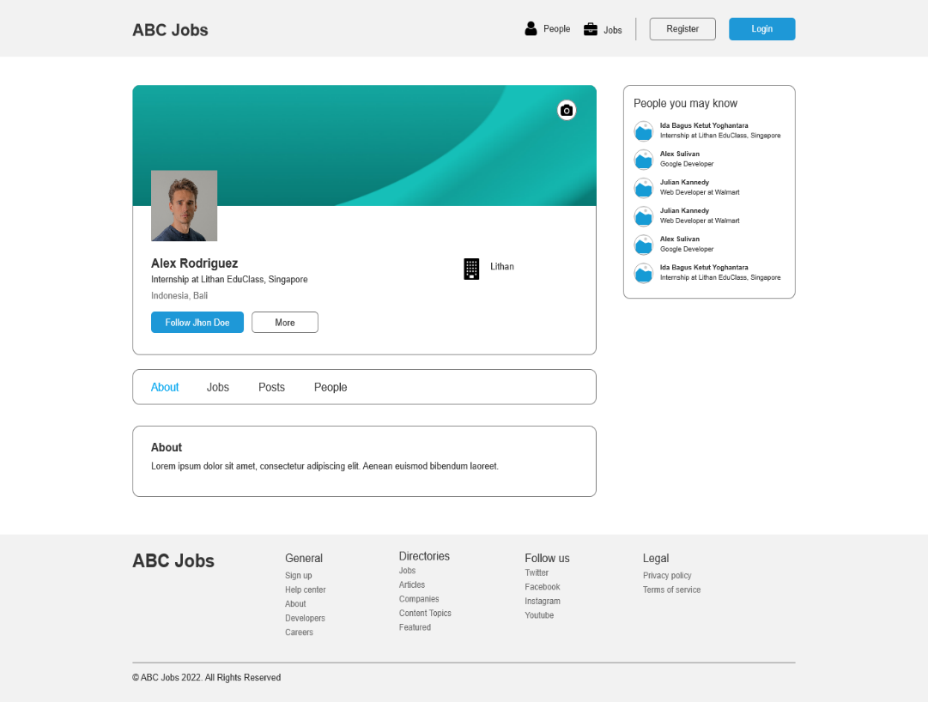
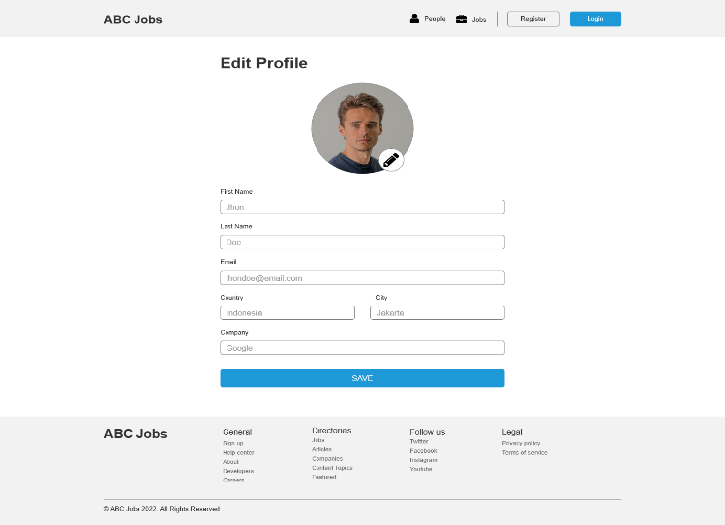
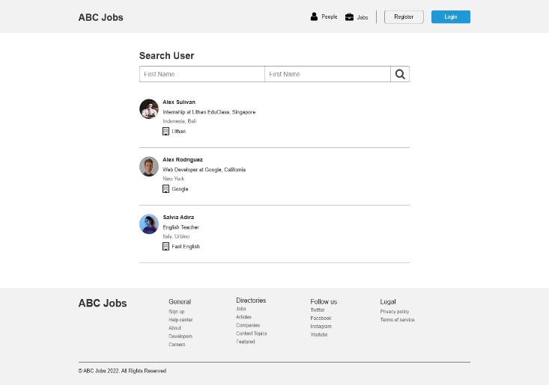
4. Forms & Pages Design
Profile Page
Edit Profile Page
Search Users Page

Slide 10
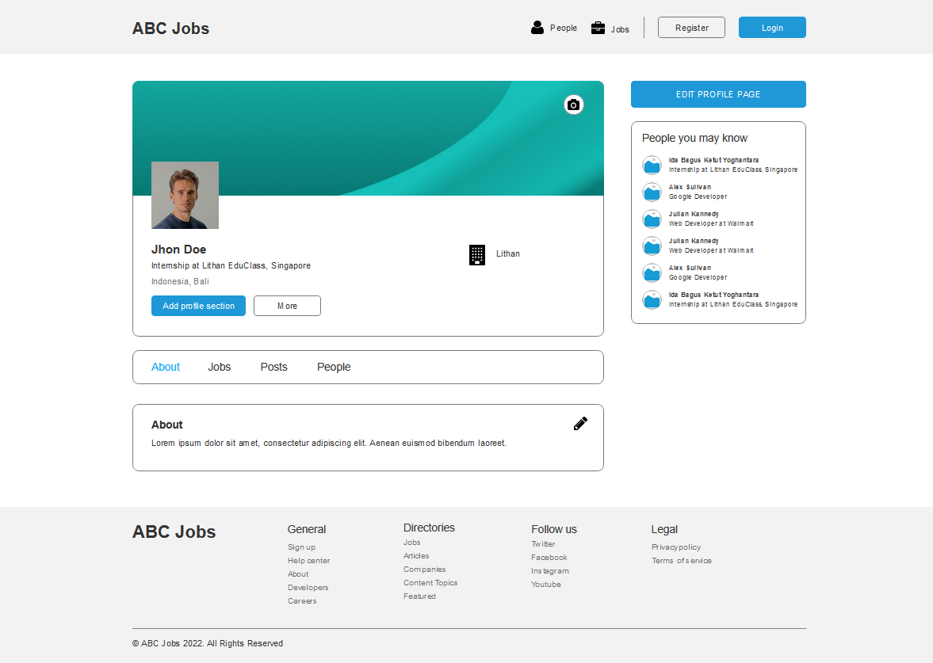

5. Forms & Pages Feedback
S. No. | Forms / Pages | Feedback Received | Modifications Implemented
1 | Profile Page | Change the Profile page to Public profile page without edit button | Yes
Before
After

Slide 11

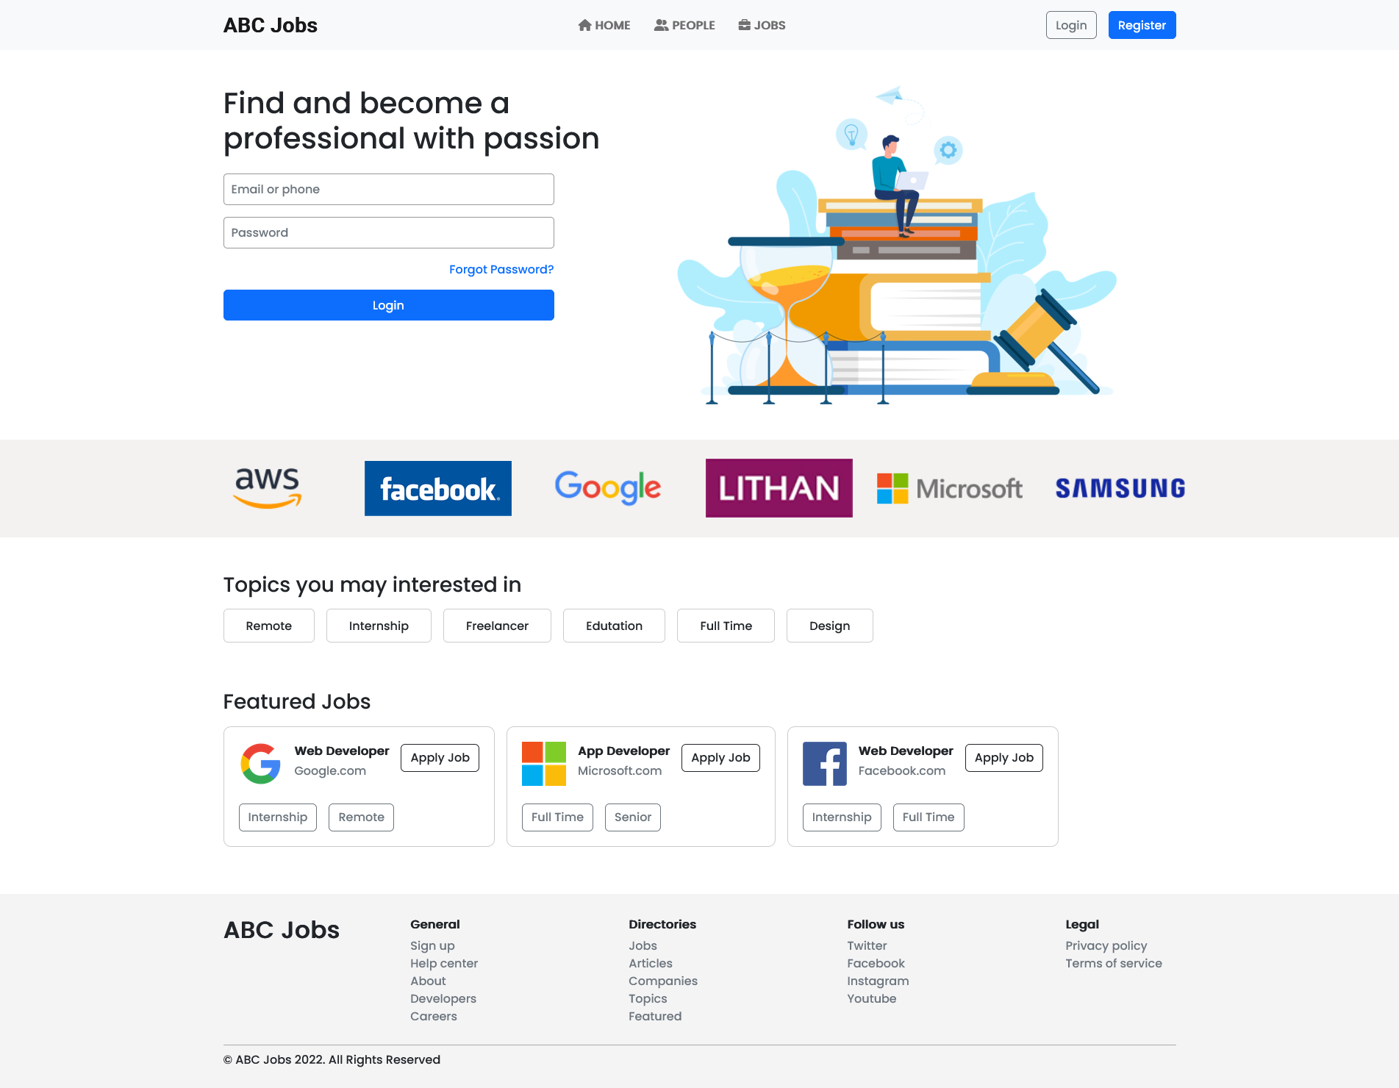
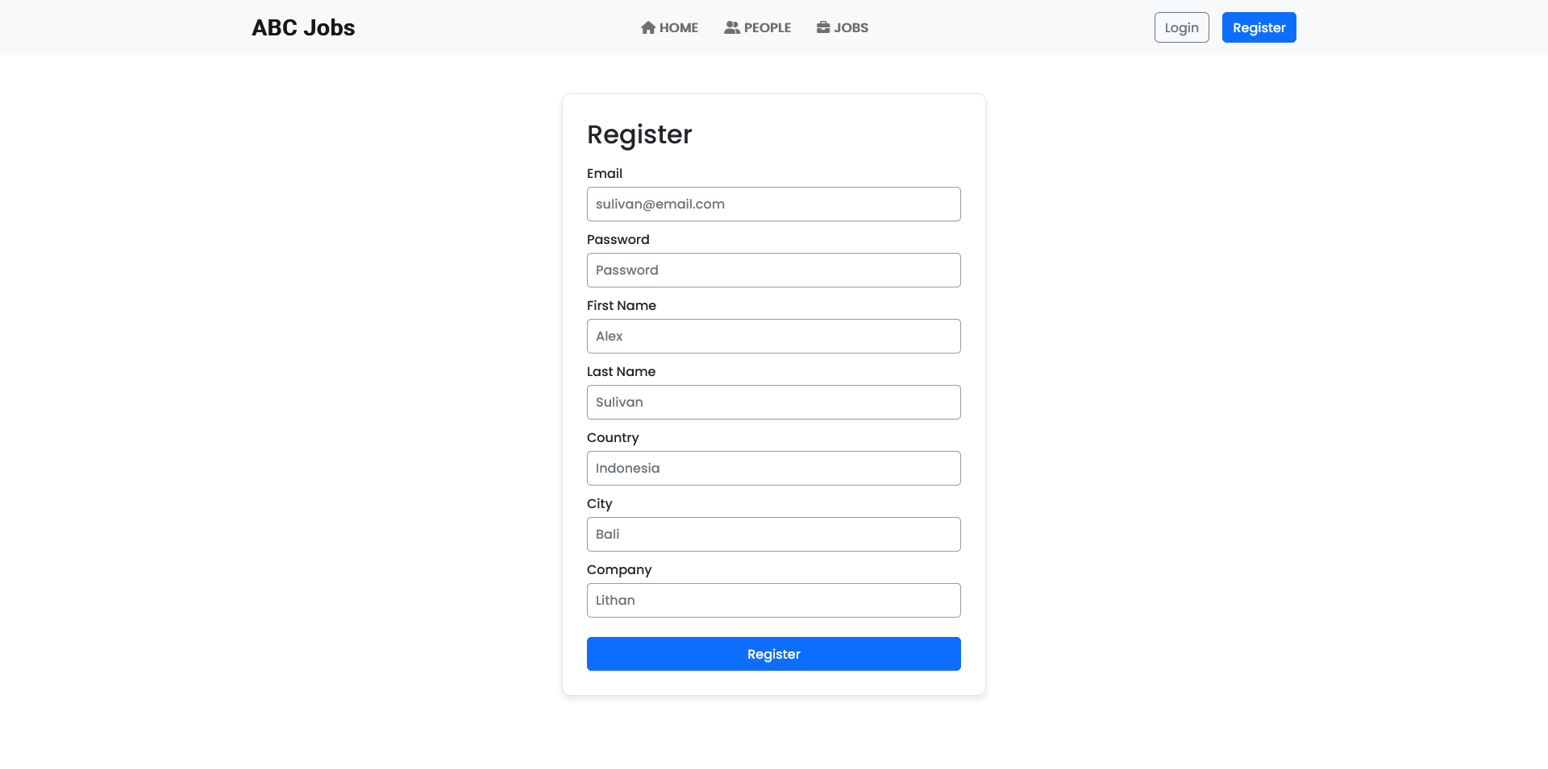
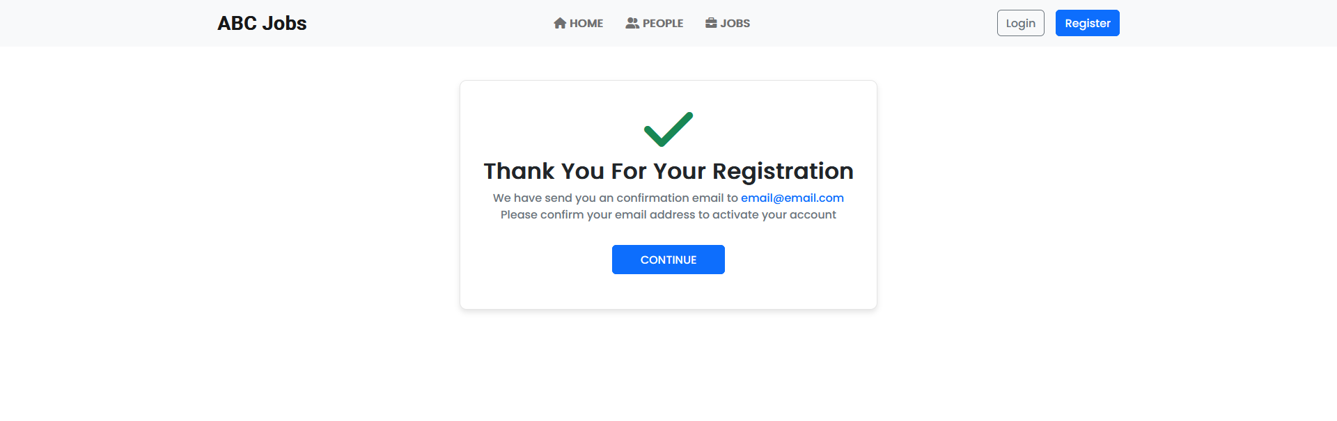
6. HTML Pages
Screen capture of Pages
Homepage
Registration Page
Registration Confirmation Page

Slide 12
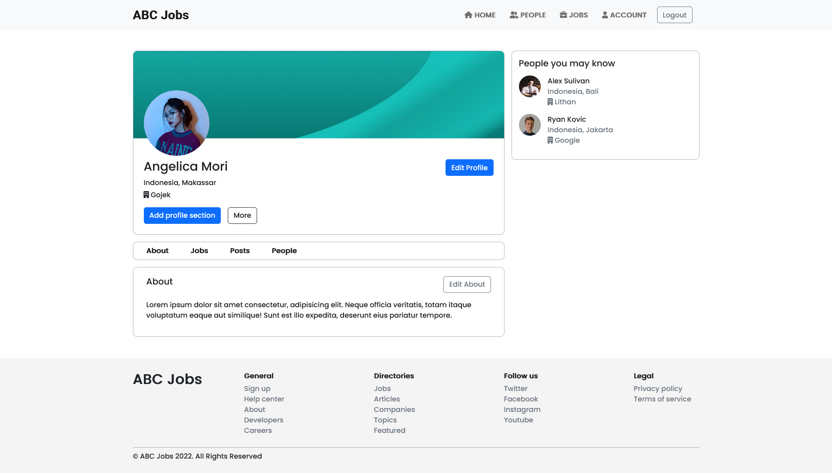
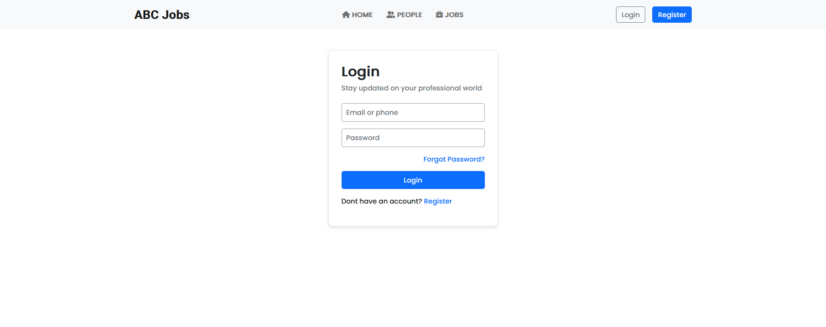
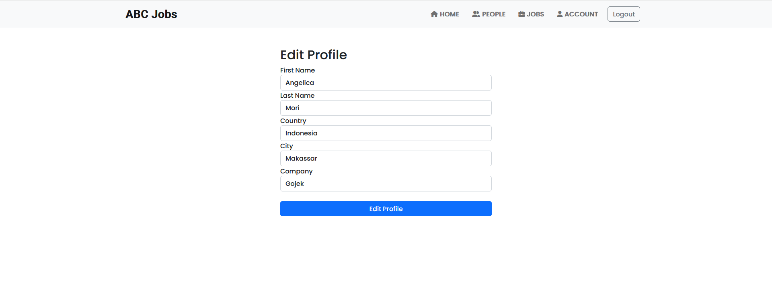
6. HTML Pages
Screen capture of Pages
Profile Page
Login Page
Edit Profile Page

Slide 13
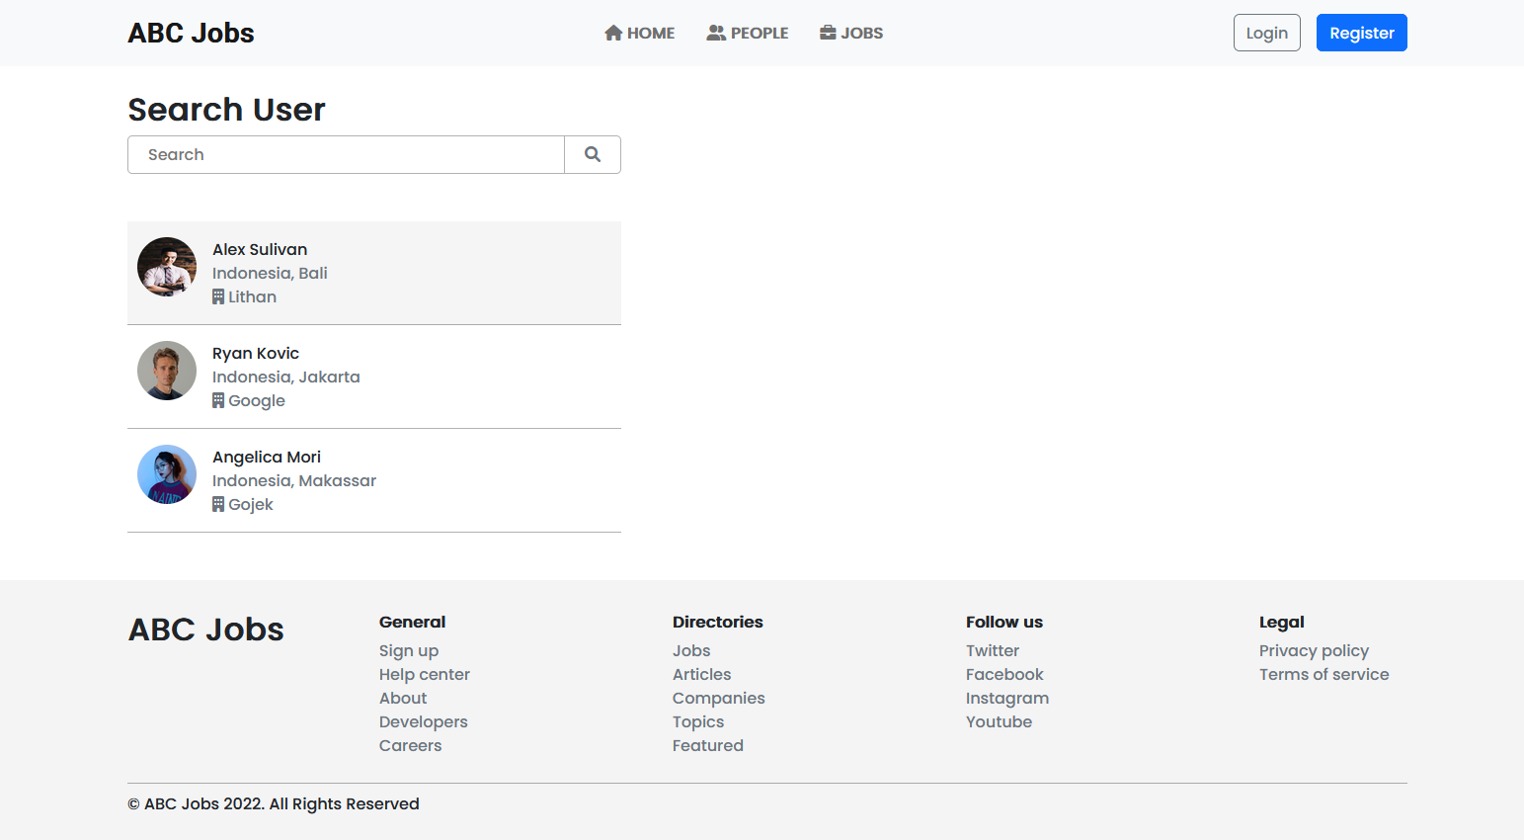
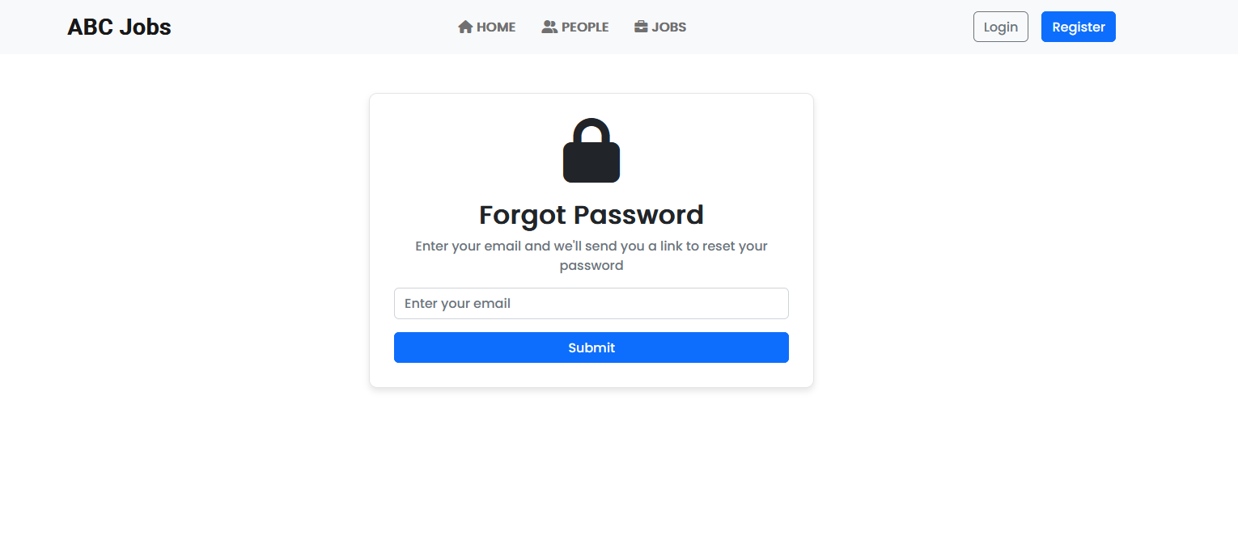
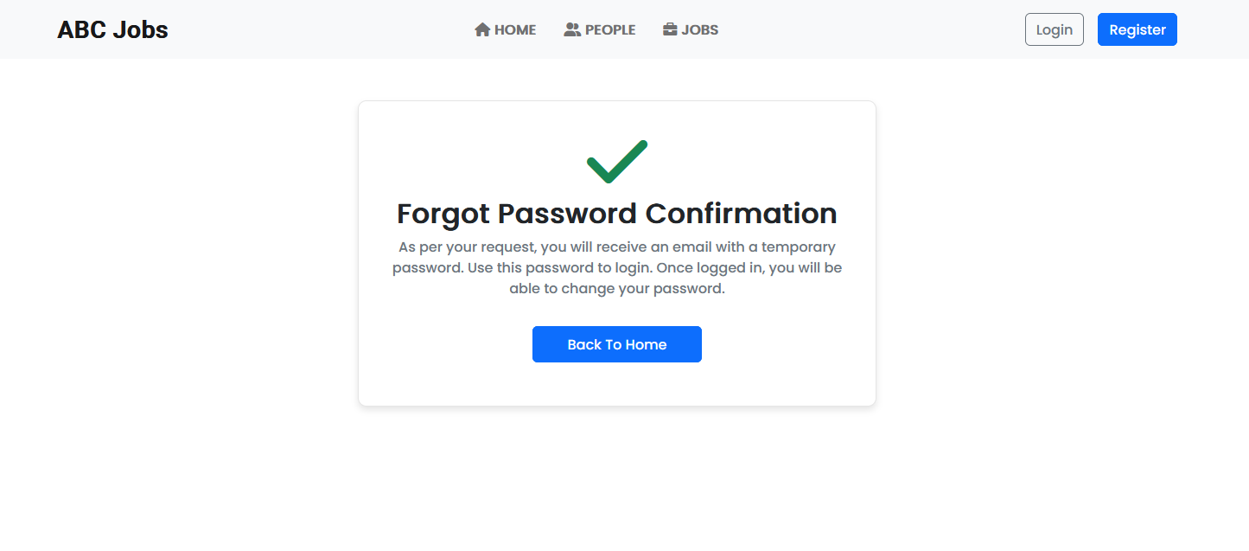
6. HTML Pages
Screen capture of Pages
Search User Page
Forgot Password Page
Forgot Password Confirmation Page

Slide 14
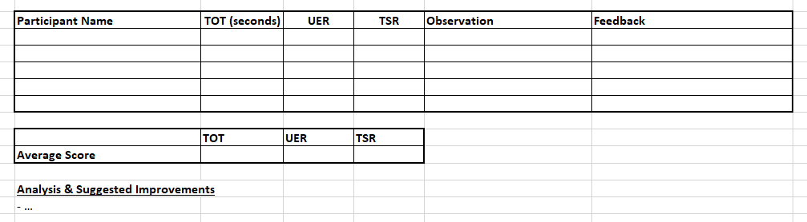
7. Usability Metrics
TOT (Time On Task): How long the time that user take to complete the task
UER (User Error Rate): Number of the mistakes that user make
TSR (Task Success Rate): Success or fail when do the task. Success is 1 and fail is 0

Slide 15

8. User Interaction Steps
Steps of user interaction
User come to landing page, at the landing page user can login by clicking the login button on the right corner of the website or on the hero banner login form.
If the user does not have any account yet, the user can register first by clicking at register button. After registration done user will be redirected to registration thankyou page and now have an account to logged in to the website.
If the user forgot their password, they can request a password retrieval by clicking the forgot password button. User input their email and will be redirected to forgot password confirmation and they will get link to their email for resetting the password.
User login to the website and redirected to their respective profile page, user can edit their profile page by clicking the edit profile button.
User can search another user profile page by clicking the people button in the navigation bar at the top of the website.
After clicking the people button the user will be redirected to search user page, user can search user by their name, country, city, and company. List of user will appear when searching in the search user page, user can click any of the users list and will be redirected to that user profile view page.

Slide 16
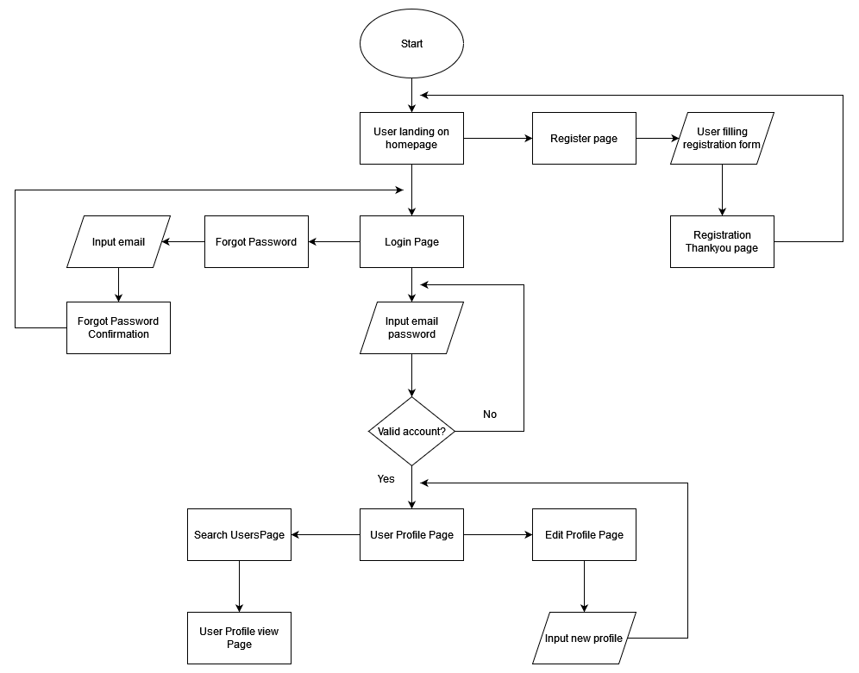
9. User Interaction Flowchart

Slide 17
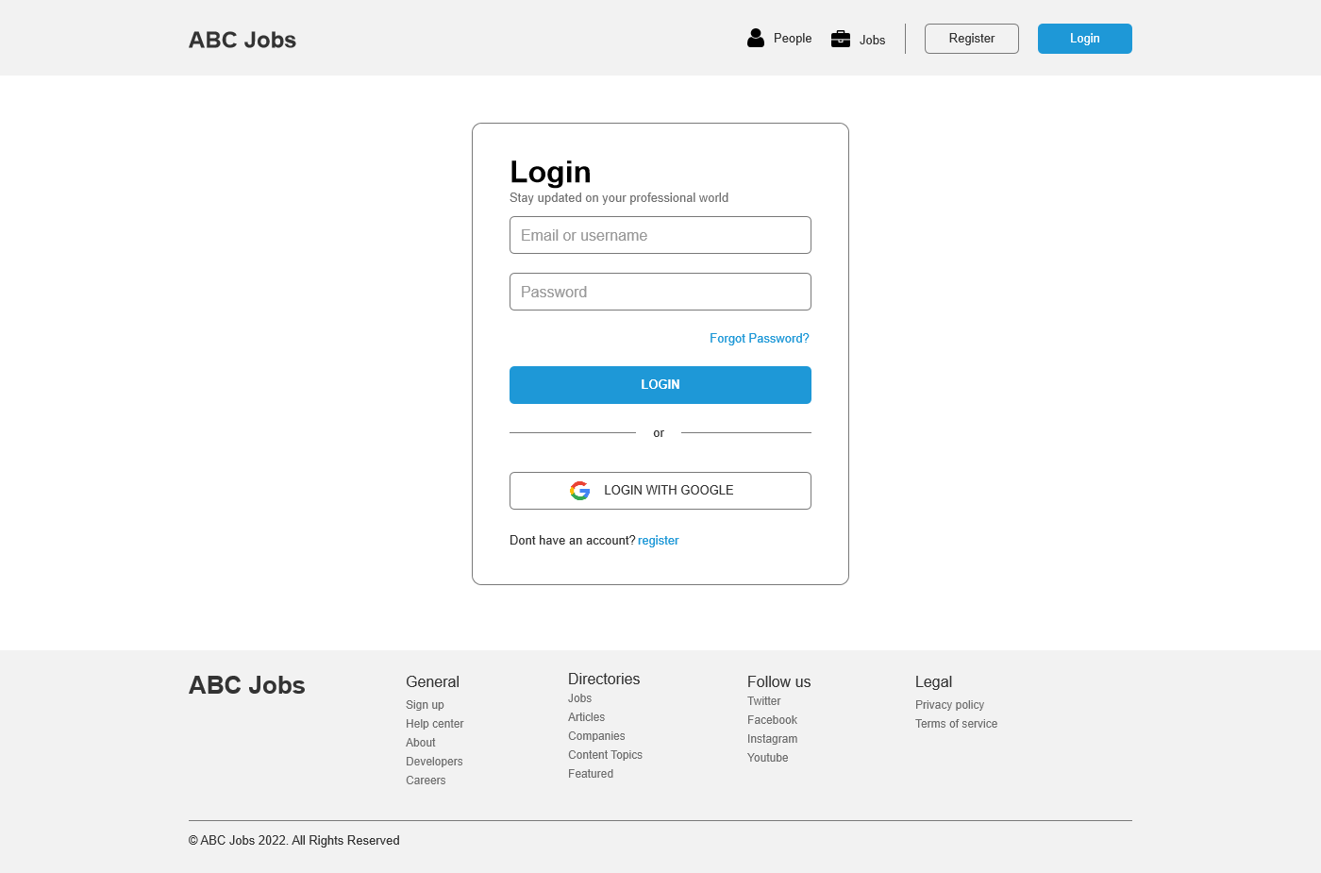

10. Prototype Screen
Login Scenario
Login Page
Profile Page

Slide 18
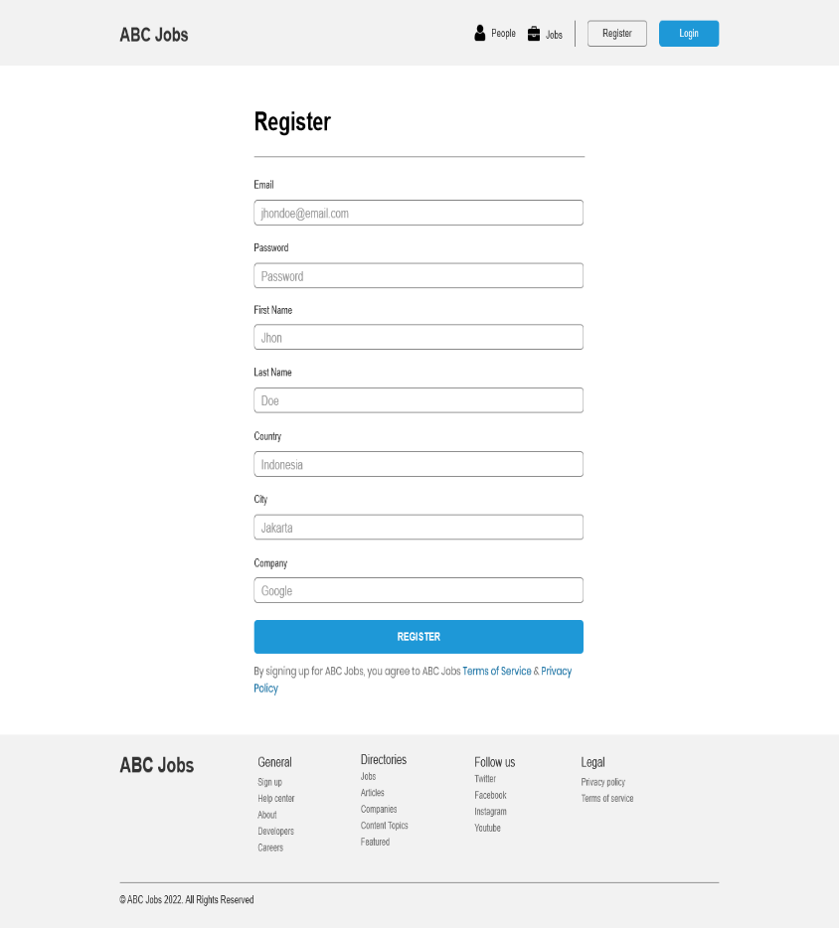

10. Prototype Screen
Registration Scenario
Registration Page
Registration Confirmation Page

Slide 19

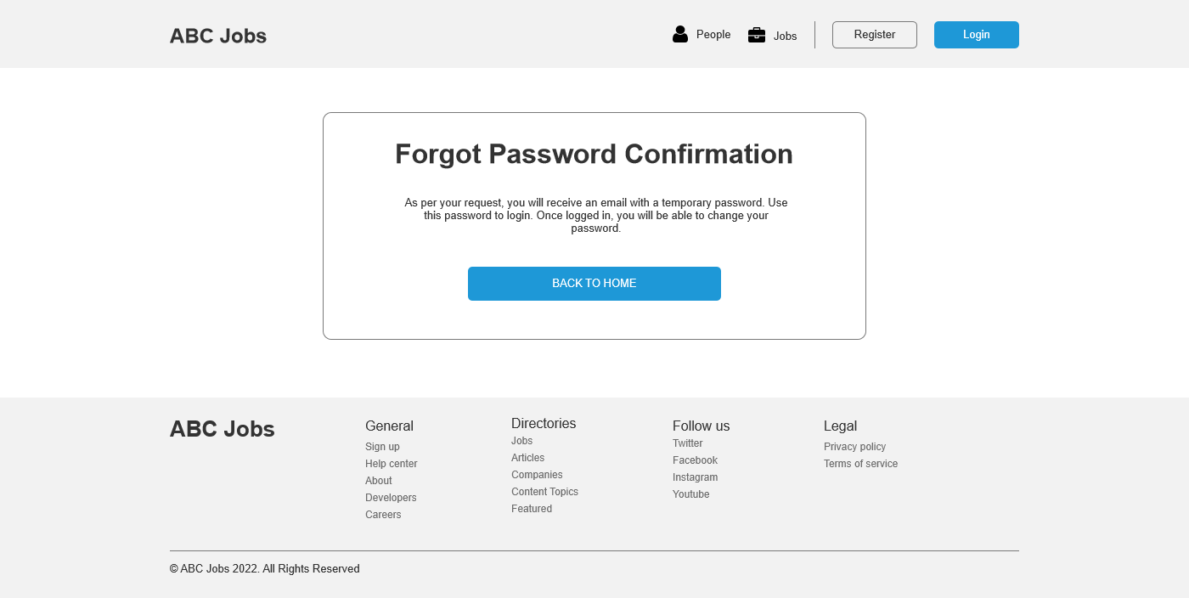
10. Prototype Screen
Forgot Password Scenario
Forgot Password Page
Forgot Password Confirmation Page

Slide 20
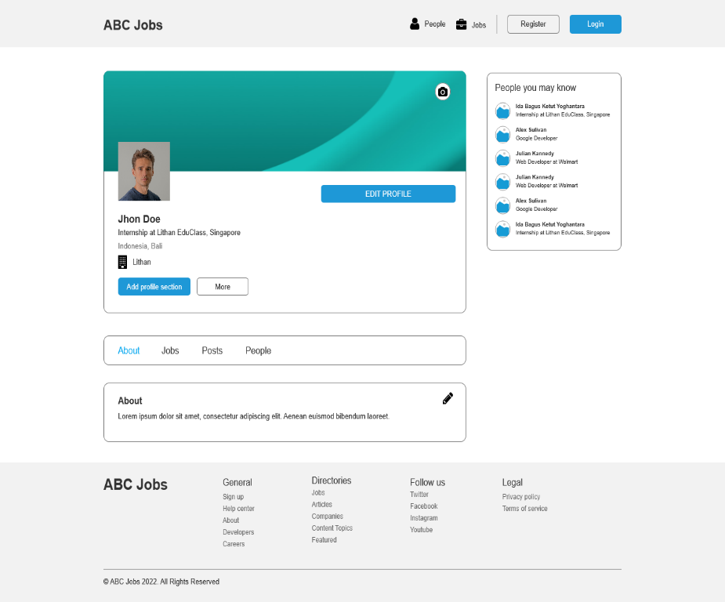
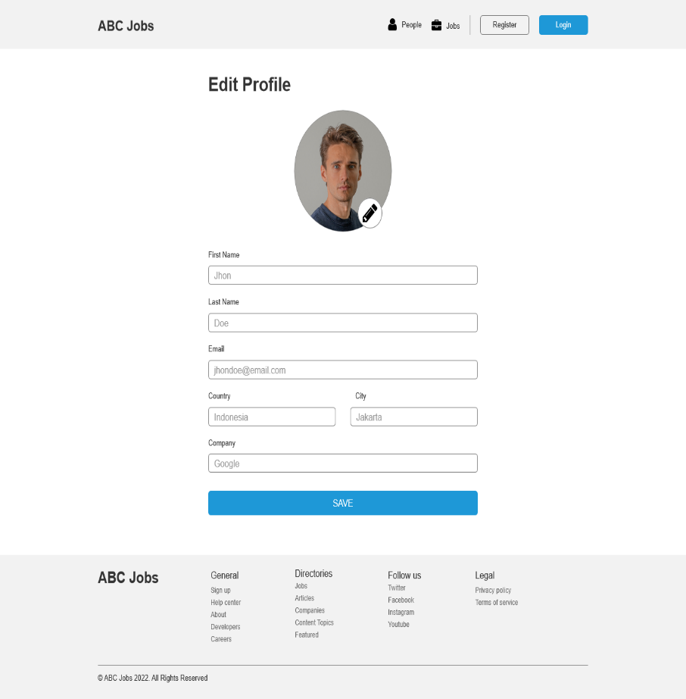
10. Prototype Screen
Edit Profile Scenario
Profile Page
Edit Profile Page

Slide 21
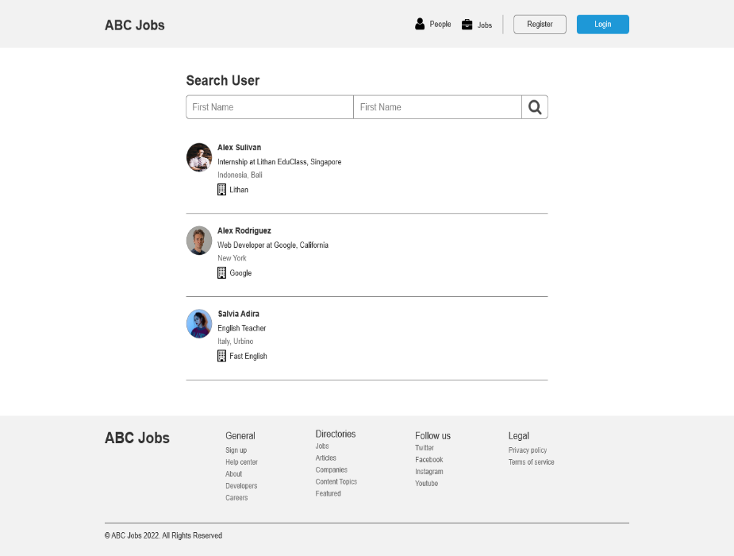

10. Prototype Screen
Search User Scenario
Search User Page
Public Profile View Page

Slide 22
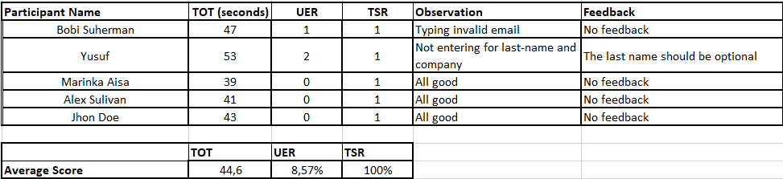
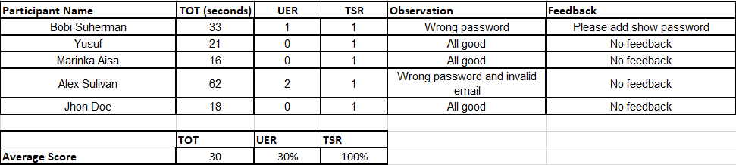
11. Usability Test
Registration Usability Test
Login Usability Test

Slide 23
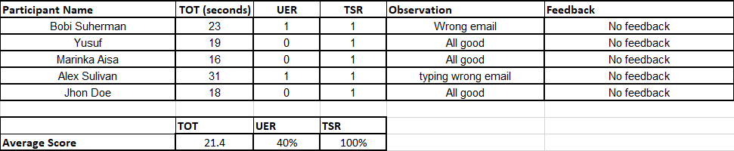
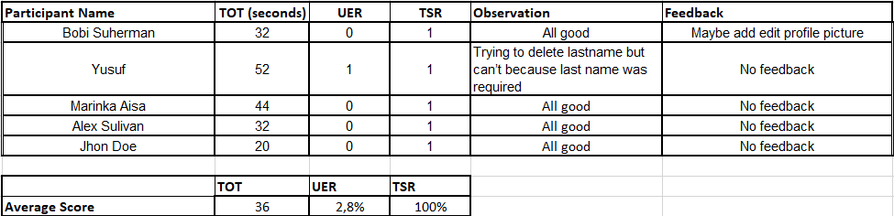
11. Usability Test
Forgot Password Usability Test
Edit Profile Usability Test

Slide 24
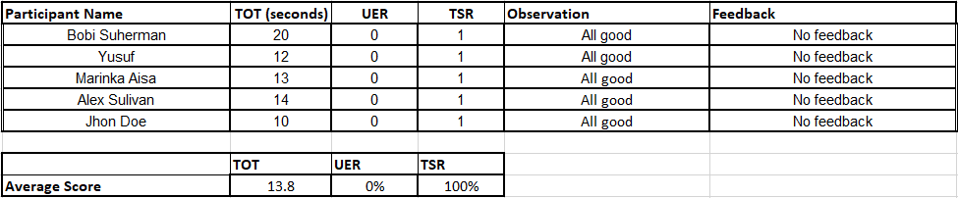
11. Usability Test
Search User Usability Test

Slide 25
12. Project Milestones & Tasks
Project Task ID | Project Task Description | Project Milestone ID
1 | Create requirement specification | 1
2 | Develop wireframe/prototype for the website | 1
3 | Develop user interaction steps and flowchart | 1
4 | Develop HTML Pages with Bootstrap and Angular | 2
5 | Analysis user experience | 2
6 | Test the application | 2

Slide 26
13. Milestone Feedback & Action taken
Project Milestone ID | Milestone Feedback received from Tutor / Learning Facilitator | Action Taken (Yes / No)
1 | Edit the private profile page to a public profile view page | Yes
2 | Add images to the profile page | Yes

Slide 27
14. Project Results (1/2)
List of HTML Pages being Produced
Homepage
Login Page
Registration Page
Registration Confirmation Page
Registration Confirmation Email page
Forgot Password Page
Forgot Password Confirmation Page
Search Users Page
Public Profile View Page
Profile Page
Edit Profile Page
Links of the Pages
Localhost:4200/login
Localhost:4200/registration
Localhost:4200/registration-confirmation
Localhost:4200/email-confirmation
Localhost:4200/search
Localhost:4200/forgot-password
Localhost:4200/forgot-password-confirmation
Localhost:4200/profile/id(i.e. 1,2,3)
Localhost:4200/profile/id(i.e. 1,2,3)/edit-profile
Localhost:4200/profile/id(i.e. 1,2,3)/first-name(i.e. Alex)

Slide 28

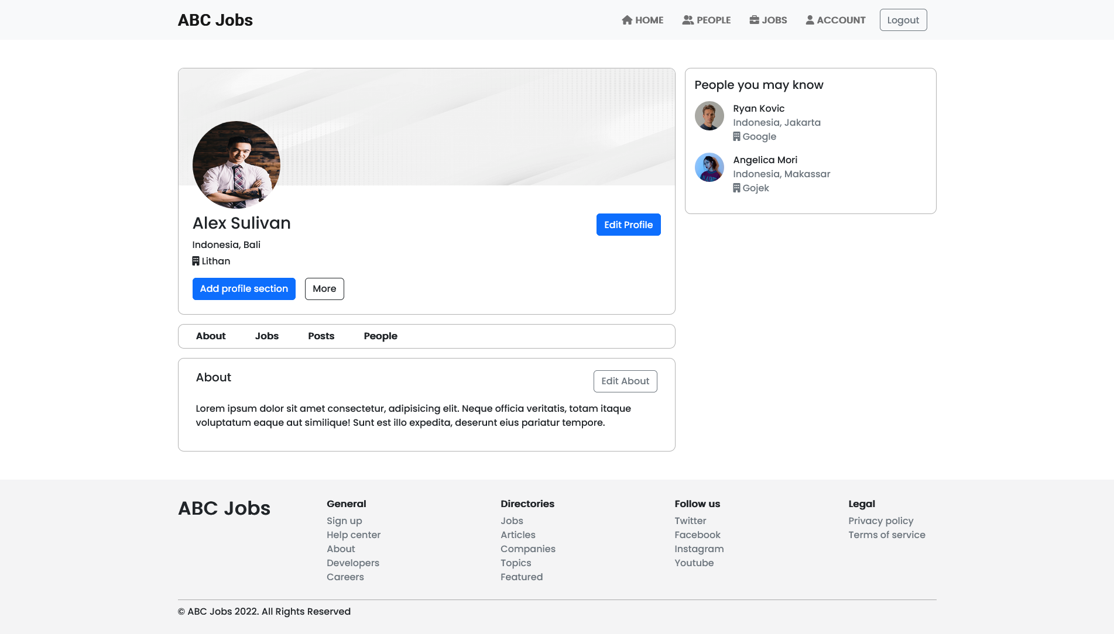
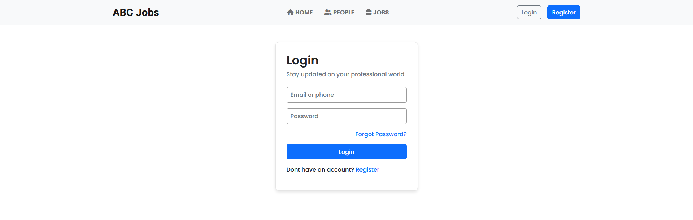
14. Project Results (2/2)
Screen Capture of Pages Using Bootstrap & Angular
Homepage
Registration page
Profile page
Login page

Slide 29

15. Proposed Improvements
List of Improvements
Using only service to get all the data to achieve good data flow/management

